Slide 1
Lattices
Appendix A

Slide 2
Outline
Overview
Definitions
Lattices
Examples

Slide 3
Overview
Lattices used to analyze several models
  Bell-LaPadula confidentiality model
  Biba integrity model
A lattice consists of a set and a relation
Relation must partially order set
  Relation orders some, but not all, elements of set

Slide 4
Sets and Relations
S set, R: S × S relation
  If a, b ∈ S, and (a, b) ∈ R, write aRb
Example
  I = { 1, 2, 3 }; R is ≤
  R = { (1, 1), (1, 2), (1, 3), (2, 2), (2, 3), (3, 3) }
  So we write 1 ≤ 2 and 3 ≤ 3 but not 3 ≤ 2

Slide 5
Relation Properties
Reflexive
  For all a ∈ S, aRa
  On I, ≤ is reflexive as 1 ≤ 1, 2 ≤ 2, 3 ≤ 3
Antisymmetric
  For all a, b ∈ S, aRb ∧ bRa ⇒ a = b
  On I, ≤ is antisymmetric as 1 ≤ x and x ≤ 1 means x = 1
Transitive
  For all a, b, c ∈ S, aRb ∧ bRc ⇒ aRc
  On I, ≤ is transitive as 1 ≤ 2 and 2 ≤ 3 means 1 ≤ 3

Slide 6
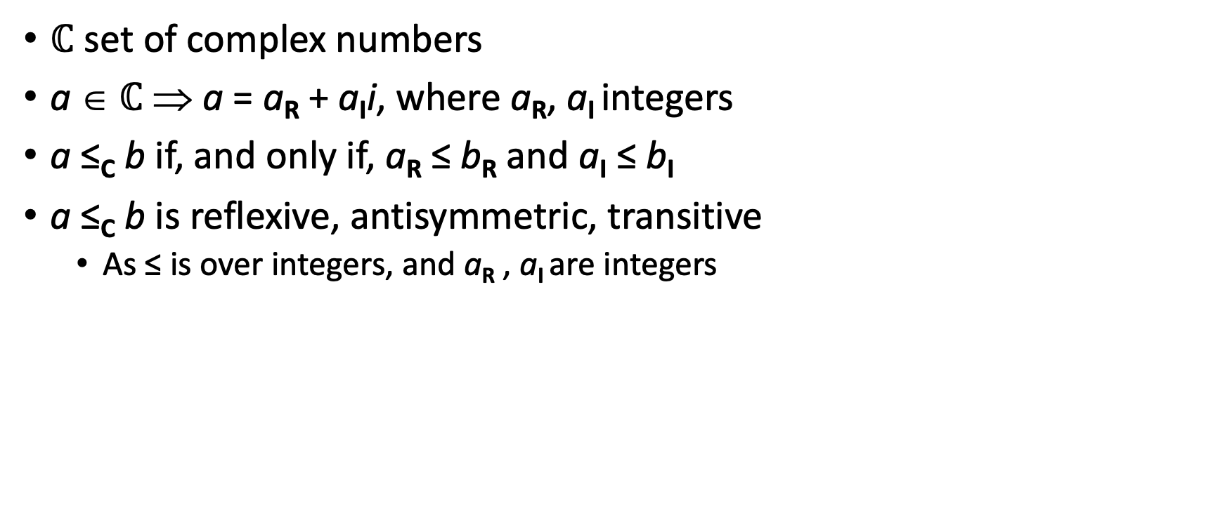
Example
$ℂ$ set of complex numbers
a ∈ $ℂ$ ⇒ a = a_{R} + a_{I}i, where a_{R}, a_{I} integers
a ≤_{C} b if, and only if, a_{R} ≤ b_{R} and a_{I} ≤ b_{I}
a ≤_{C} b is reflexive, antisymmetric, transitive
  As ≤ is over integers, and a_{R} , a_{I} are integers

Slide 7
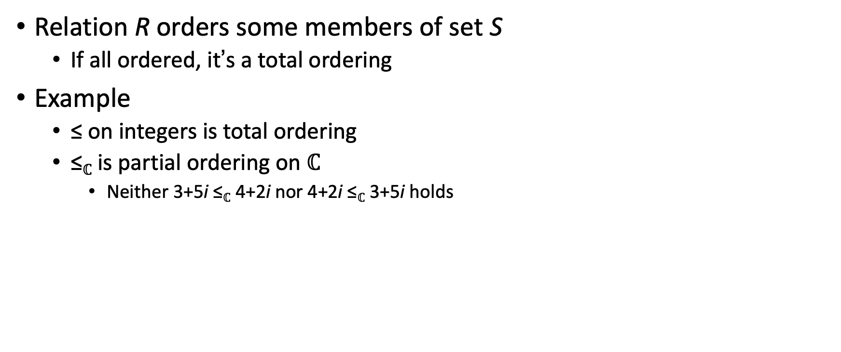
Partial Ordering
Relation R orders some members of set S
  If all ordered, it’s a total ordering
Example
  ≤ on integers is total ordering
  ≤$ℂ$ is partial ordering on $ℂ$
    Neither 3+5i ≤$ℂ$ 4+2i nor 4+2i ≤$ℂ$ 3+5i holds

Slide 8
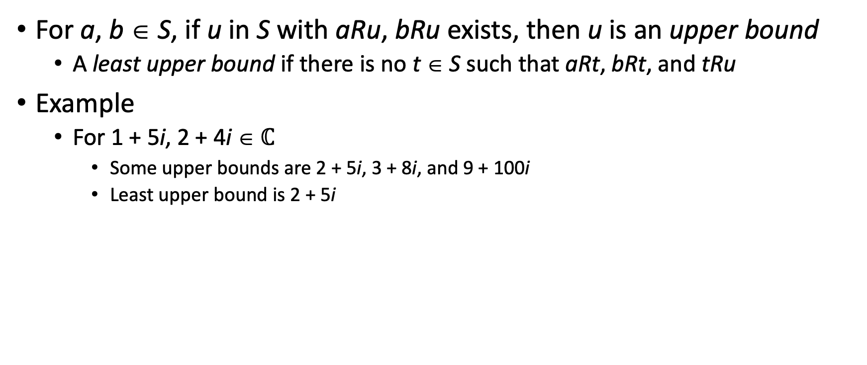
Upper Bounds
For a, b ∈ S, if u in S with aRu, bRu exists, then u is an upper bound
  A least upper bound if there is no t ∈ S such that aRt, bRt, and tRu
Example
  For 1 + 5i, 2 + 4i ∈ $ℂ$
    Some upper bounds are 2 + 5i, 3 + 8i, and 9 + 100i
    Least upper bound is 2 + 5i

Slide 9
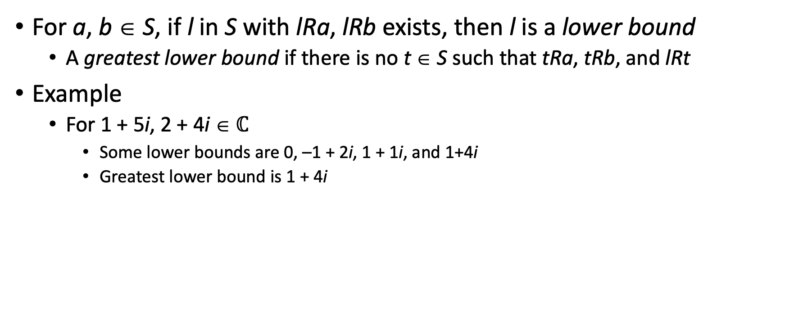
Lower Bounds
For a, b ∈ S, if l in S with lRa, lRb exists, then l is a lower bound
  A greatest lower bound if there is no t ∈ S such that tRa, tRb, and lRt
Example
  For 1 + 5i, 2 + 4i ∈ $ℂ$
    Some lower bounds are 0, –1 + 2i, 1 + 1i, and 1+4i
    Greatest lower bound is 1 + 4i

Slide 10
Lattices
Set S, relation R
  R is reflexive, antisymmetric, transitive on elements of S
  For every s, t ∈ S, there exists a greatest lower bound under R
  For every s, t ∈ S, there exists a least upper bound under R

Slide 11
Example
S = { 0, 1, 2 }; R = ≤ is a lattice
  R is clearly reflexive, antisymmetric, transitive on elements of S
  Least upper bound of any two elements of S is the greater of the elements
  Greatest lower bound of any two elements of S is the lesser of the elements

Slide 12
Picture
2
1
0
Arrows represent ≤; this forms a total ordering

Slide 13
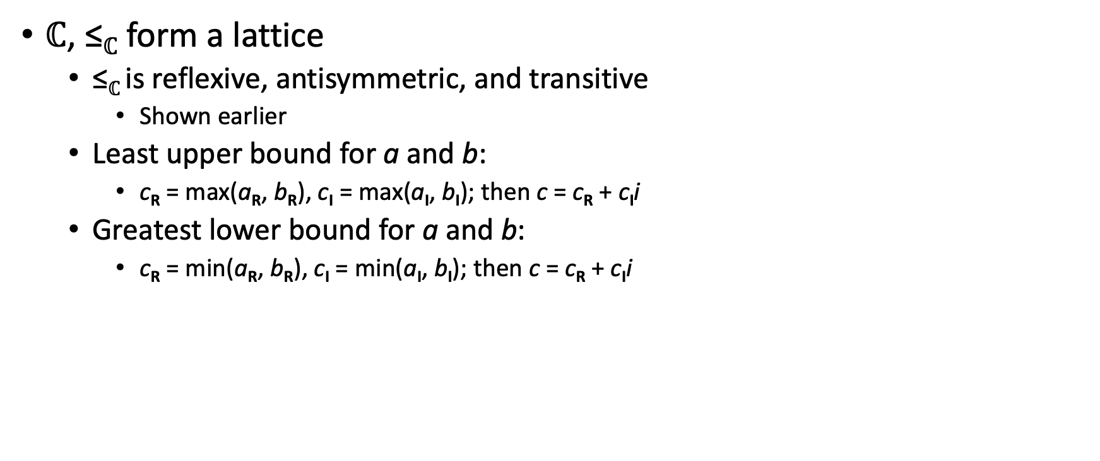
Example
$ℂ$, ≤$ℂ$ form a lattice
  ≤$ℂ$is reflexive, antisymmetric, and transitive
    Shown earlier
  Least upper bound for a and b:
    c_{R} = max(a_{R}, b_{R}), c_{I} = max(a_{I}, b_{I}); then c = c_{R} + c_{I}i
  Greatest lower bound for a and b:
    c_{R} = min(a_{R}, b_{R}), c_{I} = min(a_{I}, b_{I}); then c = c_{R} + c_{I}i

Slide 14
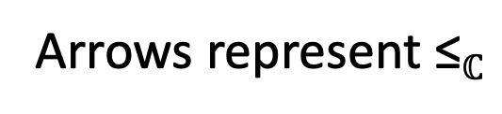
Picture
2+5i
1+5i
2+4i
1+4i
Arrows represent ≤$ℂ$

