Slide 1
Integrity Policies
Chapter 6

Slide 2
Overview
Requirements
  Very different than confidentiality policies
Biba’s models
  Strict Integrity policy
Lipner’s model
  Combines Bell-LaPadula, Biba
Clark-Wilson model
Trust models
  Policy-based
  Reputation-based

Slide 3
Requirements of Policies
Users will not write their own programs, but will use existing production programs and databases.
Programmers will develop and test programs on a non-production system; if they need access to actual data, they will be given production data via a special process, but will use it on their development system.
A special process must be followed to install a program from the development system onto the production system.
The special process in requirement 3 must be controlled and audited.
The managers and auditors must have access to both the system state and the system logs that are generated.

Slide 4
Principles of Operation
Separation of duty: if two or more steps are required to perform a critical function, at least two different people should perform the steps
Separation of function: different entities should perform different functions
Auditing: recording enough information to ensure the abilities to both recover and determine accountability

Slide 5
Biba Integrity Model
Basis for all 3 models:
Set of subjects S, objects O, integrity levels I, relation ≤ ⊆ I × I holding when second dominates first
min: I × I → I returns lesser of integrity levels
i: S ∪ O → I gives integrity level of entity
r: S × O means s ∈ S can read o ∈ O
w, x defined similarly

Slide 6
Intuition for Integrity Levels
The higher the level, the more confidence
  That a program will execute correctly
  That data is accurate and/or reliable
Note relationship between integrity and trustworthiness
Important point: integrity levels are not security levels

Slide 7
Information Transfer Path
An information transfer path is a sequence of objects o₁, ..., o_{n+1} and corresponding sequence of subjects s₁, ..., s_{n} such that s_{i} r o_{i} and s_{i} w o_{i+1} for all i, 1 ≤ i ≤ n.
Idea: information can flow from o₁ to o_{n+1} along this path by successive reads and writes

Slide 8
Low-Water-Mark Policy
Idea: when s reads o, i(s) = min(i(s), i (o)); s can only write objects at lower levels
Rules
  s ∈ S can write to o ∈ O if and only if i(o) ≤ i(s).
  If s ∈ S reads o ∈ O, then i′(s) = min(i(s), i(o)), where i′(s) is the subject’s integrity level after the read.
  s₁ ∈ S can execute s₂ ∈ S if and only if i(s₂) ≤ i(s₁).

Slide 9
Information Flow and Model
If information transfer path from o₁ ∈ O to o_{n+1} ∈ O, enforcement of low-water-mark policy requires i(o_{n+1}) ≤ i(o₁) for all n > 1.
  Idea of proof: Assume information transfer path exists between o₁ and o_{n+1}. Assume that each read and write was performed in the order of the indices of the vertices. By induction, the integrity level for each subject is the minimum of the integrity levels for all objects preceding it in path, so i(s_{n}) ≤ i(o₁). As nth write succeeds, i(o_{n+1}) ≤ i(s_{n}). Hence i(o_{n+1}) ≤ i(o₁).

Slide 10
Problems
Subjects’ integrity levels do not increase as system runs
  Soon no subject will be able to access objects at high integrity levels
Alternative: change object levels rather than subject levels
  Soon all objects will be at the lowest integrity level
Crux of problem is model prevents indirect modification
  Because subject levels lowered when subject reads from low-integrity object

Slide 11
Ring Policy
Idea: subject integrity levels static
Rules
  s ∈ S can write to o ∈ O if and only if i(o) ≤ i(s).
  Any subject can read any object.
  s₁ ∈ S can execute s₂ ∈ S if and only if i(s₂) ≤ i(s₁).
Difference with low-water-mark policy is any subject can read any object
Eliminates indirect modification problem
Same information flow result holds

Slide 12
Strict Integrity Policy
Dual of Bell-LaPadula model
  s ∈ S can read o ∈ O iff i(s) ≤ i(o)
  s ∈ S can write to o ∈ O iff i(o) ≤ i(s)
  s₁ ∈ S can execute s₂ ∈ S iff i(s₂) ≤ i(s₁)
Add compartments and discretionary controls to get full dual of Bell-LaPadula model
Information flow result holds
  Different proof, though
Term “Biba Model” refers to this

Slide 13
LOCUS and Biba
Goal: prevent untrusted software from altering data or other software
Approach: make levels of trust explicit
  credibility rating based on estimate of software’s trustworthiness (0 untrusted, n highly trusted)
  trusted file systems contain software with a single credibility level
  Process has risk level or highest credibility level at which process can execute
  Must use run-untrusted command to run software at lower credibility level

Slide 14
Integrity Matrix Model
Lipner proposed this as first realistic commercial model
Combines Bell-LaPadula, Biba models to obtain model conforming to requirements
Do it in two steps
  Bell-LaPadula component first
  Add in Biba component

Slide 15
Bell-LaPadula Clearances
2 security clearances/classifications
  AM (Audit Manager): system audit, management functions
  SL (System Low): any process can read at this level

Slide 16
Bell-LaPadula Categories
5 categories
  D (Development): production programs in development but not yet in use
  PC (Production Code): production processes, programs
  PD (Production Data): data covered by integrity policy
  SD (System Development): system programs in development but not yet in use
  T (Software Tools): programs on production system not related to protected data

Slide 17
Users and Security Levels
Subjects | Security Level
Ordinary users | (SL, { PC, PD })
Application developers | (SL, { D, T })
System programmers | (SL, { SD, T })
System managers and auditors | (AM, { D, OC, OD, SD, T })
System controllers | (SL, {D, PC, PD, SD, T}) and downgrade privilege

Slide 18
Objects and Classifications
Objects | Security Level
Development code/test data | (SL, { D, T })
Production code | (SL, { PC })
Production data | (SL, { PC, PD })
Software tools | (SL, { T })
System programs | (SL, ∅ )
System programs in modification | (SL, { SD, T })
System and application logs | (AM, { appropriate })

Slide 19
Ideas
Ordinary users can execute (read) production code but cannot alter it
Ordinary users can alter and read production data
System managers need access to all logs but cannot change levels of objects
System controllers need to install code (hence downgrade capability)
Logs are append only, so must dominate subjects writing them

Slide 20
Check Requirements
Users have no access to T, so cannot write their own programs
Applications programmers have no access to PD, so cannot access production data; if needed, it must be put into D, requiring the system controller to intervene
Installing a program requires downgrade procedure (from D to PC), so only system controllers can do it

Slide 21
More Requirements
4. Control: only system controllers can downgrade; audit: any such downgrading must be altered
5. System management and audit users are in AM and so have access to system styate and logs

Slide 22
Problem
Too inflexible
  System managers cannot run programs for repairing inconsistent or erroneous production database
    System managers at AM, production data at SL
So add more …

Slide 23
Adding Biba
3 integrity classifications
  ISP(System Program): for system programs
  IO (Operational): production programs, development software
  ISL (System Low): users get this on log in
2 integrity categories
  ID (Development): development entities
  IP (Production): production entities

Slide 24
Simplify Bell-LaPadula
Reduce security categories to 3:
  SP (Production): production code, data
  SD (Development): same as D
  SSD (System Development): same as old SD

Slide 25
Users and Levels
Subjects | Security Level | Integrity Level
Ordinary users | (SL, { SP }) | (ISL, { IP })
Application developers | (SL, { SD }) | (ISL, { ID })
System programmers | (SL, { SSD }) | (ISL, { ID })
System managers and auditors | (AM, { SP, SD, SSD }) | (ISL, { IP, ID})
System controllers | (SL, { SP, SD }) and downgrade privilege | (ISP, { IP, ID})
Repair | (SL, { SP }) | (ISL, { IP })

Slide 26
Objects and Classifications
Objects | Security Level | Integrity Level
Development code/test data | (SL, { SD }) | (ISL, { IP} )
Production code | (SL, { SP }) | (IO, { IP })
Production data | (SL, { SP }) | (ISL, { IP })
Software tools | (SL, ∅ ) | (IO, { ID })
System programs | (SL, ∅ ) | (ISP, { IP, ID })
System programs in modification | (SL, { SSD }) | (ISL, { ID })
System and application logs | (AM, { appropriate }) | (ISL, ∅ )
Repair | (SL, {SP}) | (ISL, { IP })

Slide 27
Ideas
Security clearances of subjects same as without integrity levels
Ordinary users need to modify production data, so ordinary users must have write access to integrity category IP
Ordinary users must be able to write production data but not production code; integrity classes allow this
  Note writing constraints removed from security classes

Slide 28
Clark-Wilson Integrity Model
Integrity defined by a set of constraints
  Data in a consistent or valid state when it satisfies these
Example: Bank
  D today’s deposits, W withdrawals, YB yesterday’s balance, TB today’s balance
  Integrity constraint: D + YB –W
Well-formed transaction move system from one consistent state to another
Issue: who examines, certifies transactions done correctly?

Slide 29
Entities
CDIs: constrained data items
  Data subject to integrity controls
UDIs: unconstrained data items
  Data not subject to integrity controls
IVPs: integrity verification procedures
  Procedures that test the CDIs conform to the integrity constraints
TPs: transaction procedures
  Procedures that take the system from one valid state to another

Slide 30
Certification Rules 1 and 2
CR1 When any IVP is run, it must ensure all CDIs are in a valid state
CR2 For some associated set of CDIs, a TP must transform those CDIs in a valid state into a (possibly different) valid state
  Defines relation certified that associates a set of CDIs with a particular TP
  Example: TP balance, CDIs accounts, in bank example

Slide 31
Enforcement Rules 1 and 2
ER1 The system must maintain the certified relations and must ensure that only TPs certified to run on a CDI manipulate that CDI.
ER2 The system must associate a user with each TP and set of CDIs. The TP may access those CDIs on behalf of the associated user. The TP cannot access that CDI on behalf of a user not associated with that TP and CDI.
  System must maintain, enforce certified relation
  System must also restrict access based on user ID (allowed relation)

Slide 32
Users and Rules
CR3 The allowed relations must meet the requirements imposed by the principle of separation of duty.
ER3 The system must authenticate each user attempting to execute a TP
  Type of authentication undefined, and depends on the instantiation
  Authentication not required before use of the system, but is required before manipulation of CDIs (requires using TPs)

Slide 33
Logging
CR4 All TPs must append enough information to reconstruct the operation to an append-only CDI.
  This CDI is the log
  Auditor needs to be able to determine what happened during reviews of transactions

Slide 34
Handling Untrusted Input
CR5 Any TP that takes as input a UDI may perform only valid transformations, or no transformations, for all possible values of the UDI. The transformation either rejects the UDI or transforms it into a CDI.
  In bank, numbers entered at keyboard are UDIs, so cannot be input to TPs. TPs must validate numbers (to make them a CDI) before using them; if validation fails, TP rejects UDI

Slide 35
Separation of Duty In Model
ER4 Only the certifier of a TP may change the list of entities associated with that TP. No certifier of a TP, or of an entity associated with that TP, may ever have execute permission with respect to that entity.
  Enforces separation of duty with respect to certified and allowed relations

Slide 36
Comparison With Requirements
Users can’t certify TPs, so CR5 and ER4 enforce this
Procedural, so model doesn’t directly cover it; but special process corresponds to using TP
  No technical controls can prevent programmer from developing program on production system; usual control is to delete software tools
TP does the installation, trusted personnel do certification

Slide 37
Comparison With Requirements
4. CR4 provides logging; ER3 authenticates trusted personnel doing installation; CR5, ER4 control installation procedure
  New program UDI before certification, CDI (and TP) after
Log is CDI, so appropriate TP can provide managers, auditors access
  Access to state handled similarly

Slide 38
Comparison to Biba
Biba
  No notion of certification rules; trusted subjects ensure actions obey rules
  Untrusted data examined before being made trusted
Clark-Wilson
  Explicit requirements that actions must meet
  Trusted entity must certify method to upgrade untrusted data (and not certify the data itself)

Slide 39
UNIX Implementation
Considered “allowed” relation
(user, TP, { CDI set })
Each TP is owned by a different user
  These “users” are actually locked accounts, so no real users can log into them; but this provides each TP a unique UID for controlling access rights
  TP is setuid to that user
Each TP’s group contains set of users authorized to execute TP
Each TP is executable by group, not by world

Slide 40
CDI Arrangement
CDIs owned by root or some other unique user
  Again, no logins to that user’s account allowed
CDI’s group contains users of TPs allowed to manipulate CDI
Now each TP can manipulate CDIs for single user

Slide 41
Examples
Access to CDI constrained by user
  In “allowed” triple, TP can be any TP
  Put CDIs in a group containing all users authorized to modify CDI
Access to CDI constrained by TP
  In “allowed” triple, user can be any user
  CDIs allow access to the owner, the user owning the TP
  Make the TP world executable

Slide 42
Problems
2 different users cannot use same copy of TP to access 2 different CDIs
  Need 2 separate copies of TP (one for each user and CDI set)
TPs are setuid programs
  As these change privileges, want to minimize their number
root can assume identity of users owning TPs, and so cannot be separated from certifiers
  No way to overcome this without changing nature of root

Slide 43
Trust Models
Integrity models state conditions under which changes preserve a set of properties
  So deal with the preservation of trustworthiness
Trust models deal with confidence one can have in the initial values or settings
  So deal with the initial evaluation of whether data can be trusted

Slide 44
Definition of Trust
A trusts B if A believes, with a level of subjective probability, that B will perform a particular action, both before the action can be monitored (or independently of the capacity of being able to monitor it) and in a context in which it affects Anna’s own action.
Includes subjective nature of trust
Captures idea that trust comes from a belief in what we do not monitor
Leads to transitivity of trust

Slide 45
Transitivity of Trust
Transitivity of trust: if A trusts B and B trusts C, then A trusts C
Not always; depends on A’s assessment of B’s judgment
Conditional transitivity of trust: A trusts C when
  B recommends C to A;
  A trusts B’s recommendations;
  A can make judgments about B’s recommendations; and
  Based on B’s recommendation, A may trust C less than B does
Direct trust: A trusts C because of A’s observations and interactions
Indirect trust: A trusts C because A accepts B’s recommendation

Slide 46
Types of Beliefs Underlying Trust
Competence: A believes B competent to aid A in reaching goal
Disposition: A believes B will actually do what A needs to reach goal
Dependence: A believes she needs what B will do, depends on what B will do, or it’s better to rely on B than not
Fulfillment: A believes goal will be reached
Willingness: A believes B has decided to do what A wants
Persistence: A believes B will not change B’s mind before doing what A wants
Self-confidence: A believes that B knows B can take the action A wants

Slide 47
Evaluating Arguments about Trust (con’t)
Majority behavior: A’s belief that most people from B’s community are trustworthy
Prudence: Not trusting B poses unacceptable risk to A
Pragmatism: A’s current interests best served by trusting B

Slide 48
Trust Management
Use a language to express relationships about trust, allowing us to reason about trust
  Evaluation mechanisms take data, trust relationships and provide a measure of trust about the entity or whether an action should or should not be taken
Two basic forms
  Policy-based trust management
  Reputation-based trust management

Slide 49
Policy-Based Trust Management
Credentials instantiate policy rules
  Credentials are data, so they too may be input to the rules
  Trusted third parties often vouch for credentials
Policy rules expressed in a policy language
  Different languages for different goals
  Expressiveness of language determines the policies it can express

Slide 50
Example: Keynote
Basic units
  Assertions: describe actions allowed to possessors of credentials
    Policy: statements about policy
    Credential: statements about credentials
  Action environment: attributes describing action associated with credentials
Evaluator: takes set of policy assertions, set of credentials, action environment and determines if proposed action is consistent with policy

Slide 51
Example
Consider email domain: policy assertion authorizes holder of mastercred for all actions:
  Authorizer: "POLICY"
  Licensees: "mastercred"
Credential assertion:
  KeyNote-Version: 2
  Local-Constants: Alice="cred1234", Bob="credABCD"
  Authorizer: "authcred"
  Licensees: Alice || Bob
  Conditions: (app_domain == "RFC822-EMAIL") &&
  (address ˜= "ˆ.*@keynote\\.ucdavis\\.edu$")
  Signature: "signed"
Compliance Value Set: { “_MIN_TRUST”, “_MAX_TRUST” }

Slide 52
Example: Results
Evaluator given action environment:
  _ACTION_AUTHORIZERS=Alice
  app_domain = "RFC822-EMAIL"
  address = "snoopy@keynote.ucdavis.edu"
it satisfies policy, so returns _MAX_TRUST
Evaluator given action environment:
  _ACTION_AUTHORIZERS=Bob
  app_domain = "RFC822-EMAIL"
  address = ”opus@admin.ucdavis.edu"
it does not satisfy policy, so returns _MIN_TRUST

Slide 53
Example 2
Consider separation of duty: policy assertion delegates authority to pay invoices to entity with credential “fundmgrcred”:
  Authorizer: "POLICY"
  Licensee: "fundmgecred"
  Conditions: (app_domain == "INVOICE" && @dollars < 10000)
Credential assertion (requires 2 signatures on any expenditure:
  KeyNote-Version: 2
  Comment: This credential specifies a spending policy
  Authorizer: "authcred"
  Licensees: 2-of("cred1", "cred2", "cred3", "cred4", "cred5")
  Conditions: (app_domain=="INVOICE") # note nested clauses
  -> { (@dollars) < 2500) -> "Approve";
  (@dollars < 7500) -> "ApproveAndLog"; };
  Signature: "signed"
Compliance Value Set: { “Reject”, “ApproveAndLog”, “Approve” }

Slide 54
Example 2: Results
Evaluator given action environment:
  _ACTION_AUTHORIZERS = "cred1,cred4"
  app_domain = "INVOICE"
  dollars = "1000"
it satisfies first clause of condition, and so policy, so returns Approve
Evaluator given action environment:
  _ACTION_AUTHORIZERS = "cred1"
  app_domain = "INVOICE"
  dollars = "1500"
it does not satisfy policy as too few Licensees, so returns Reject

Slide 55
Example 2: Results
Evaluator given action environment:
  _ACTION_AUTHORIZERS = "cred1,cred2"
  app_domain = "INVOICE"
  dollars = "3541"
it satisfies second clause of condition, and so policy, so returns ApproveAndLog
Evaluator given action environment:
  _ACTION_AUTHORIZERS = "cred1,cred5"
  app_domain = "INVOICE"
  dollars = "8000"
it does not satisfy policy as amount too large, so returns Reject

Slide 56
Reputation-Based Trust Management
Use past behavior, information from other sources, to determine whether to trust an entity
Some models distinguish between direct, indirect trust
Trust category, trust values, agent’s identification form reputation
Recommendation is trust information containing at least 1 reputation
Systems use many different types of metrics
  Statistical models
  Belief models (probabilities may not sum to 1, due to uncertainty in belief)
  Fuzzy models (reasoning involves degrees of trustworthiness)

Slide 57
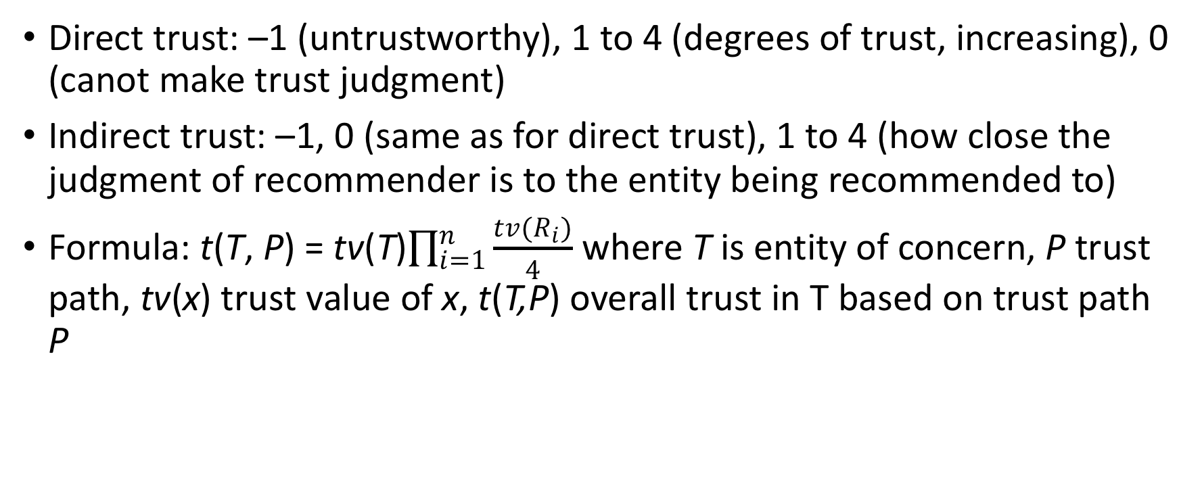
Example 1
Direct trust: –1 (untrustworthy), 1 to 4 (degrees of trust, increasing), 0 (canot make trust judgment)
Indirect trust: –1, 0 (same as for direct trust), 1 to 4 (how close the judgment of recommender is to the entity being recommended to)
Formula: t(T, P) = tv(T)$\prod_{i=1}^{n}{\frac{tv(R_{i})}{4}}$ where T is entity of concern, P trust path, tv(x) trust value of x, t(T,P) overall trust in T based on trust path P

Slide 58
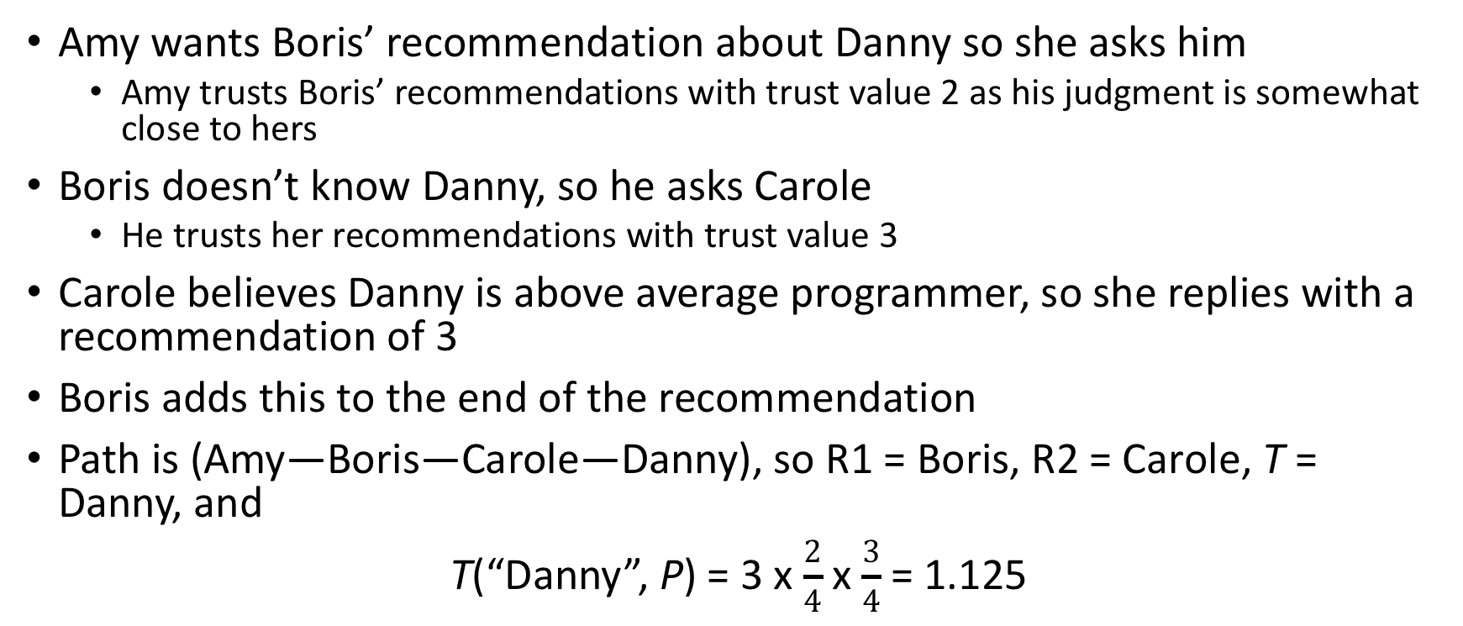
Example 1
Amy wants Boris’ recommendation about Danny so she asks him
  Amy trusts Boris’ recommendations with trust value 2 as his judgment is somewhat close to hers
Boris doesn’t know Danny, so he asks Carole
  He trusts her recommendations with trust value 3
Carole believes Danny is above average programmer, so she replies with a recommendation of 3
Boris adds this to the end of the recommendation
Path is (Amy—Boris—Carole—Danny), so R1 = Boris, R2 = Carole, T = Danny, and
T(“Danny”, P) = 3 x $\frac{2}{4}$ x $\frac{3}{4}$ = 1.125

Slide 59
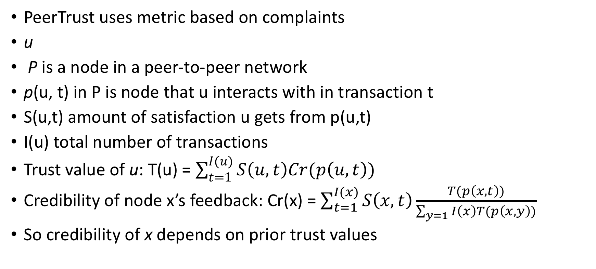
Example 2
PeerTrust uses metric based on complaints
u
P is a node in a peer-to-peer network
p(u, t) in P is node that u interacts with in transaction t
S(u,t) amount of satisfaction u gets from p(u,t)
I(u) total number of transactions
Trust value of u: T(u) = $\sum_{t=1}^{I(u)}{S\left(u,t\right)Cr(p\left(u,t\right))}$
Credibility of node x’s feedback: Cr(x) = $\sum_{t=1}^{I(x)}{S\left(x,t\right)\frac{T(p\left(x,t\right))}{\sum_{y=1}{I\left(x\right)T(p\left(x,y\right))}}}$
So credibility of x depends on prior trust values

Slide 60
Key Points
Integrity policies deal with trust
  As trust is hard to quantify, these policies are hard to evaluate completely
  Look for assumptions and trusted users to find possible weak points in their implementation
Biba, Lipner based on multilevel integrity
Clark-Wilson focuses on separation of duty and transactions

